Slide 1

USWDS Monthly Call
February 2024

Slide 2

Hi!
Thanks for being here!

Slide 3
Agenda
Site launches
Product updates
Component lifecycle and proposals
Q&A

Slide 4
Site launches

Slide 5
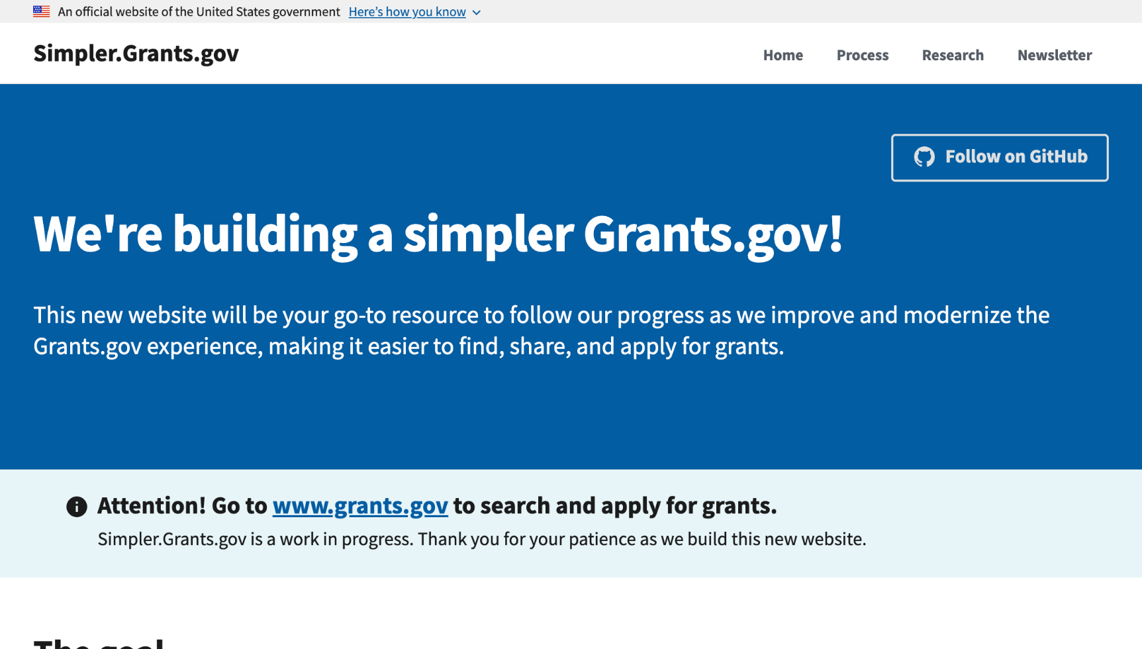
Grants.gov
simpler.grants.gov

Slide 6
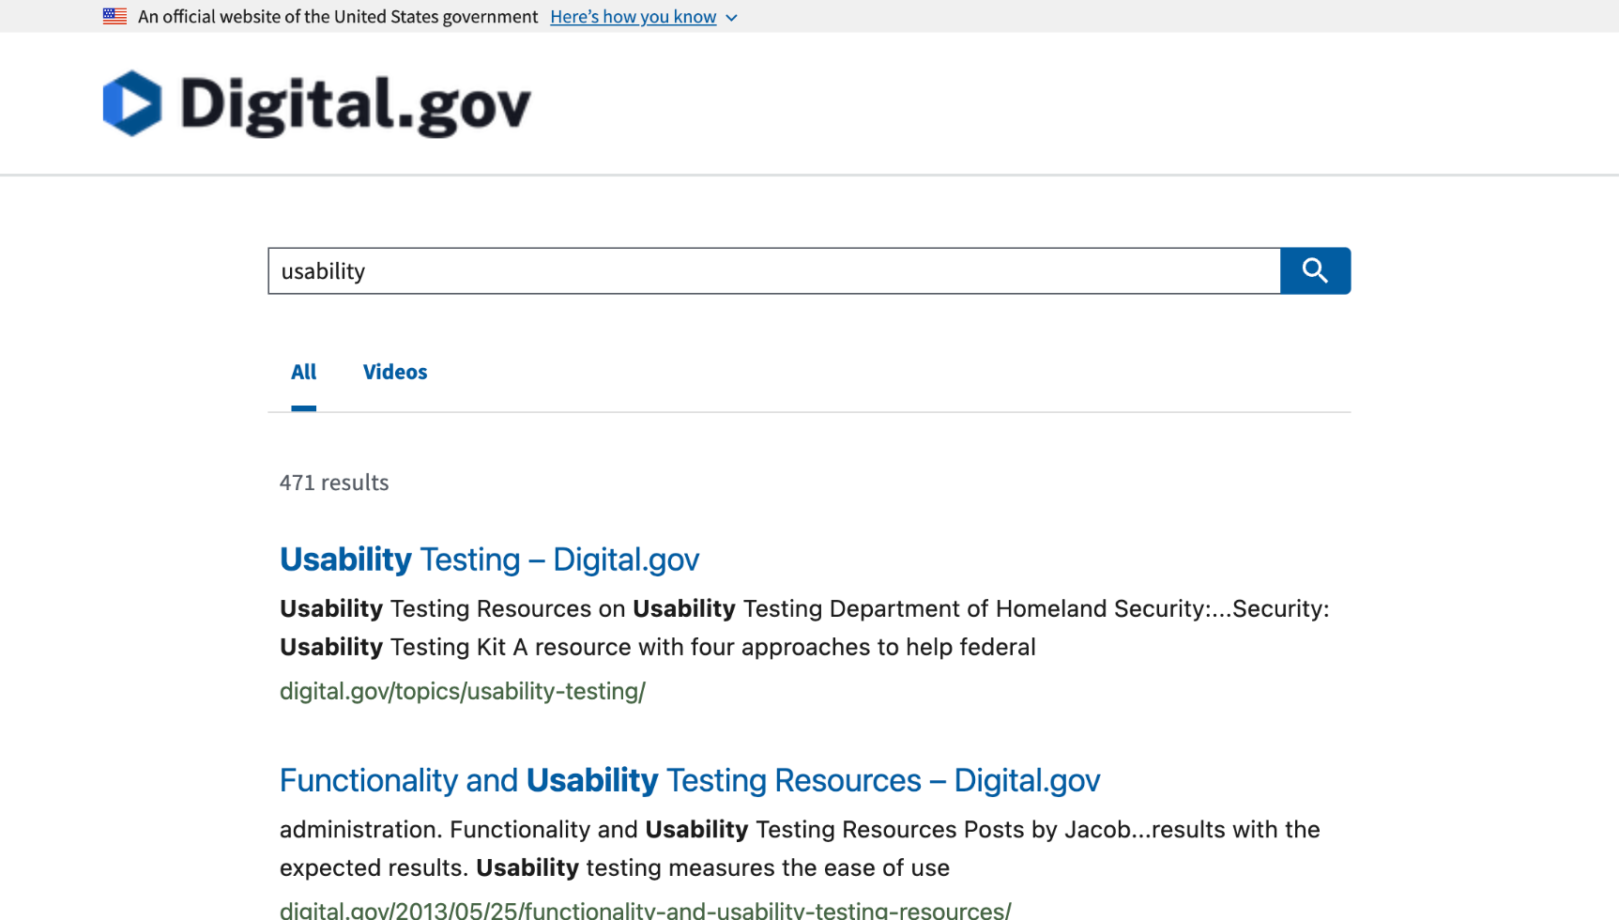
Search.gov hosted results on Digital.gov
digital.gov

Slide 7
Great work!

Slide 8
Product updates

Slide 9
USWDS 3.8.0
Coming in February

Slide 10
Accessibility tests

Slide 11
Coming in February
Table
Icon
Typography

Slide 12
Component lifecycle and new component proposals

Slide 13
Where we’re going

Slide 14
Polestar
We help government teams align, design, and keep their websites and services up to date

Slide 15
Vision
Empowered and supported digital service teams.
Familiar and easy-to-use digital services.

Slide 16
Mission
Shaping the future of government digital services

Slide 17
Why component lifecycle now?

Slide 18
A model of how the design system itself grows and matures

Slide 19
Connect digital design and delivery teams across government

Slide 20
Our government is big.

Slide 21
A real mission-driven commitment to human centered design

Slide 22
Our challenge: Convert aggregate skills into common infrastructure

Slide 23
Splitting bigger problems into smaller problems

Slide 24
The food truck scenario:
Smaller commitments grow participation

Slide 25
What if there were smaller steps between nothing and everything?

Slide 26
How can we lower the barrier to participation?

Slide 27
How can we enable contribution?

Slide 28
How can we reduce up-front requirements?

Slide 29
And how can we establish conversation and communication?

Slide 30
Amy Leadem
she/her
Developer
USWDS Contractor

Slide 31
Anne Petersen
they/them
Experience Design Lead
USWDS

Slide 32
Phases

Slide 33
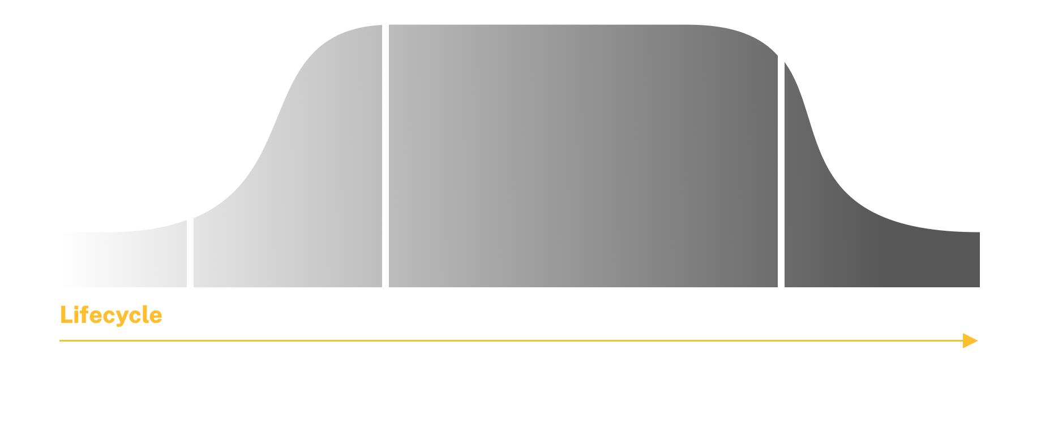
The overall shape

Slide 34
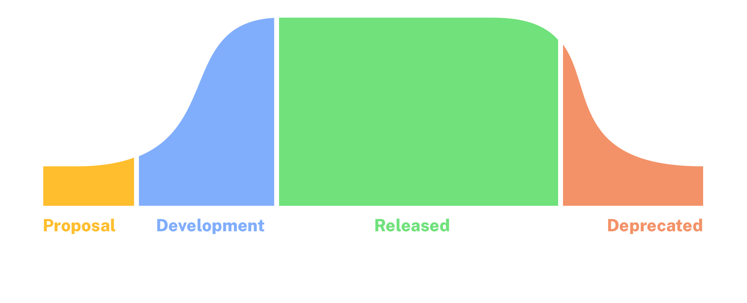
Lifecycle phases

Slide 35
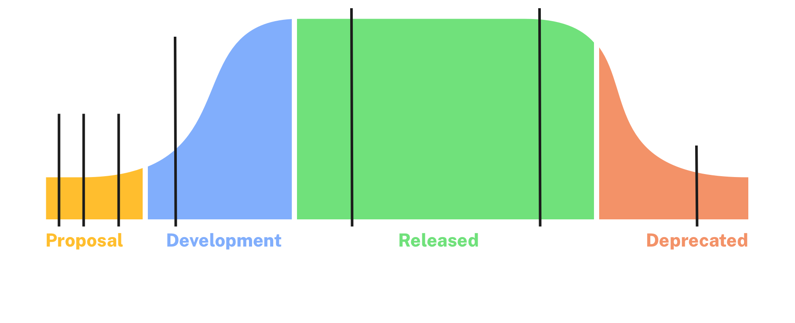
Lifecycle sub-phases

Slide 36
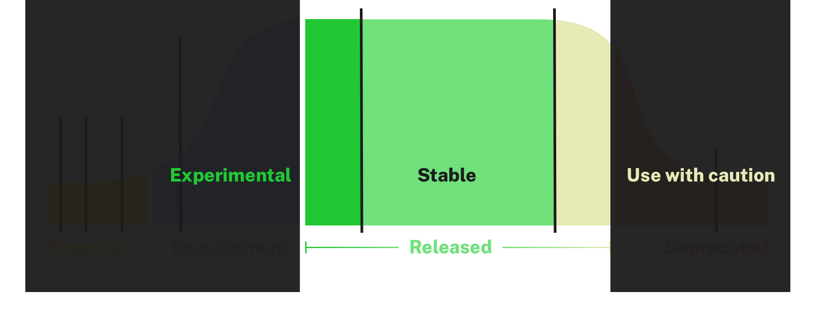
The Experimental step of the Released phase

Slide 37
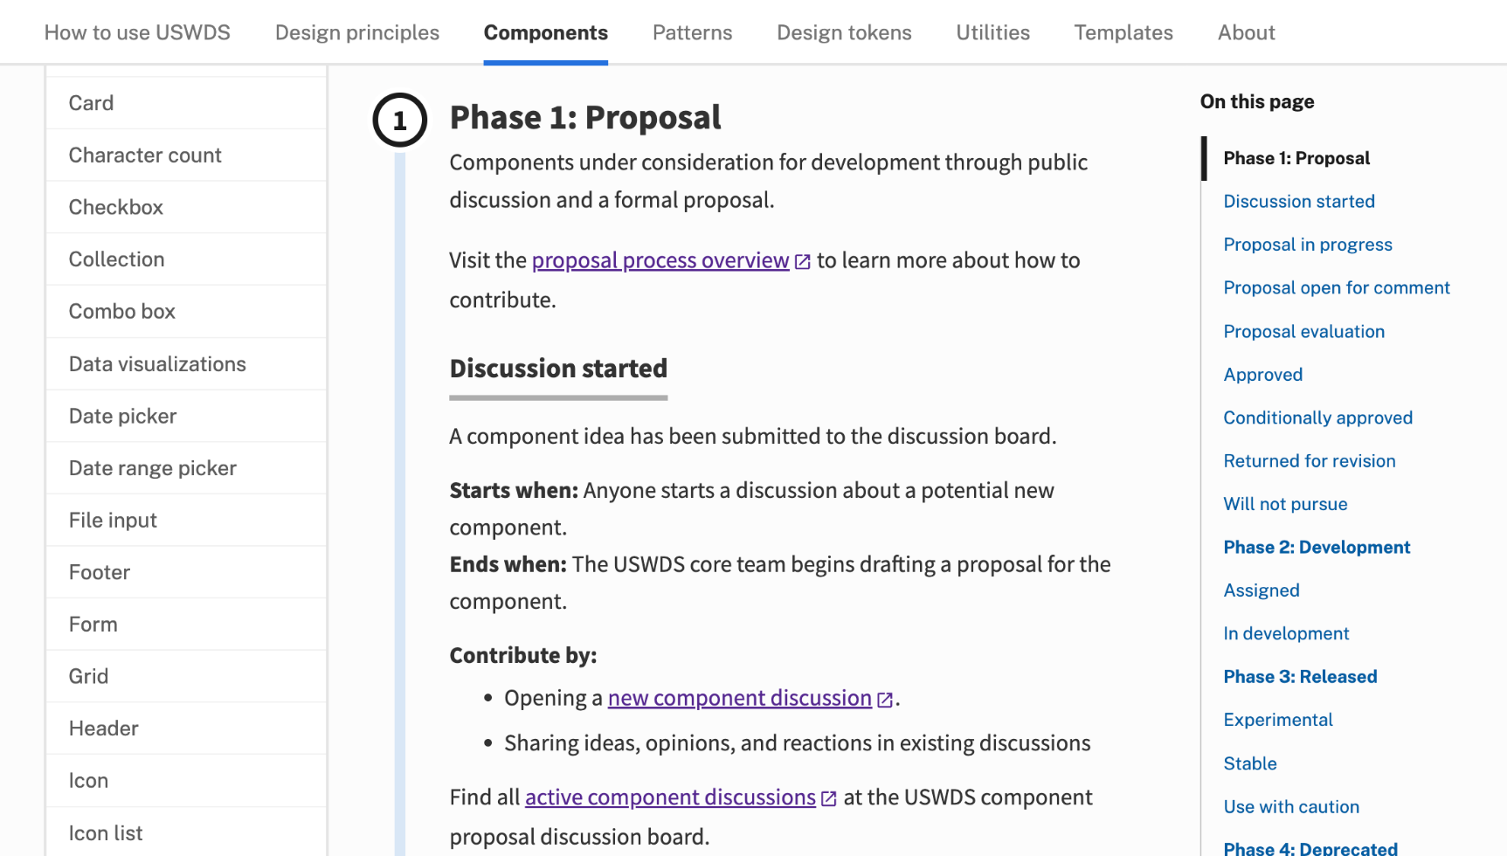
Component lifecycle page
designsystem.digital.gov/components/lifecycle

Slide 38
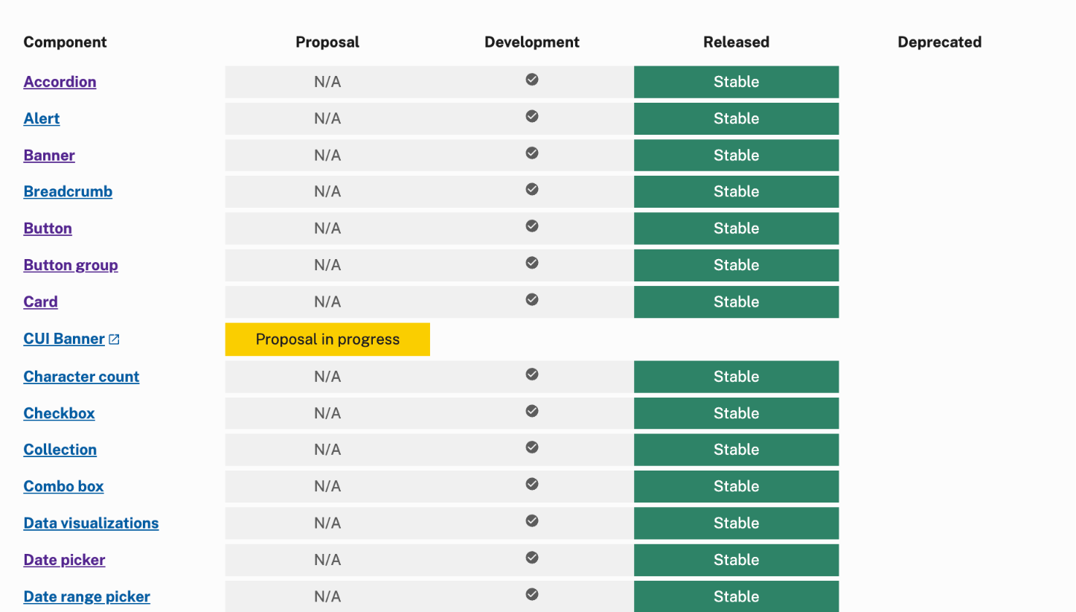
Component status page
designsystem.digital.gov/components/status

Slide 39
Our component status page

Slide 40
What’s next?

Slide 41
Iteration! In action!

Slide 42
Our assumption: We’ll need more clarity

Slide 43
Starting from our stated values

Slide 44
Public, practical, easy-to-understand requirements

Slide 45
This process is in beta

Slide 46
Where to start?
At the beginning.

Slide 47
Starting with
the component proposal process

Slide 48
Starting with
a discussion

Slide 49
Finding the elephant

Slide 50
The elephant in the room: a proposal for a component

Slide 51
We need discussions

Slide 52
The shape of a proposal

Slide 53
Not a requirements doc, but a case

Slide 54
Not prescriptive, actionable

Slide 55
The more participation, the better the proposals

Slide 56
Proposals:
How we introduce new component ideas and evaluate them

Slide 57
Intuitive

Slide 58
Incremental

Slide 59
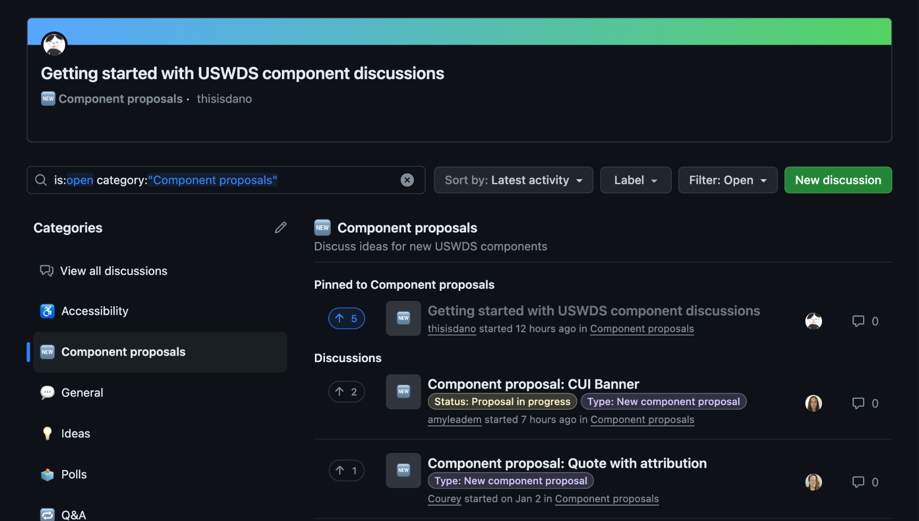
The frontstage: A component proposal discussion board

Slide 60
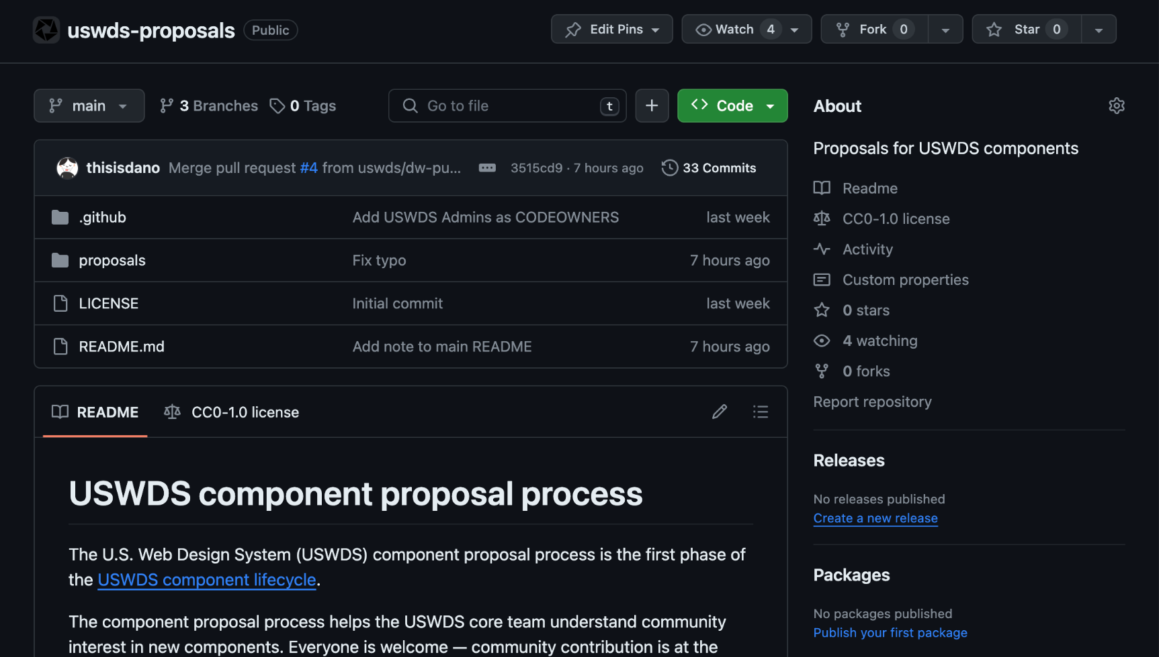
The backstage: A component proposal repo

Slide 61
Component proposal board: The central hub for community discussion about new USWDS component ideas

Slide 62
Why discussion boards?
Threaded comments
Sorting, filtering, and labels
Upvoting

Slide 63
Are you interested in suggesting a new component?
and
Is there already an existing discussion?

Slide 64
Incremental, informal, and persistent

Slide 65
New discussion
github.com/uswds/uswds/
discussions/categories/component-proposals

Slide 66
How do we turn discussions into proposals?

Slide 67
We are looking to collect a few specific bits of information

Slide 68
General information
What’s the common name (or names) of this component?
What gap does it fill in the design system?
How is this different from existing USWDS components?
Does this component directly support any federal laws, guidance, or policies?

Slide 69
Potential design ideas and context
What’s the potential core functionality of the component?
Are there any examples of how the component might work?

Slide 70
Appropriate use cases
What common interactions does this component support?
What does this component need to do to be successful and effective?
What kind of content would be ideal for this component?

Slide 71
Inappropriate use cases
Are there common ways this type of component is misused?
Are there similar interactions that would be better supported by other components?
What kind of content should teams not use with this component?

Slide 72
UX considerations
What are the characteristics of a successful interaction with this component?
What would make this component less usable?
What are common pitfalls or implementation mistakes associated with this component?
How might the mobile context affect how you use this component?

Slide 73
Accessibility considerations
Will this component cause difficulty for people who use any assistive technologies?
Could this component be difficult for any other audiences?

Slide 74
Potential stakeholders, advocates, and volunteers
Folks willing to help design, develop, or test the component
Significant support from an agency or group

Slide 75
We’ll collect this information into a formal proposal in our uswds-proposals repo.

Slide 76
Proposal → Comment → Assignment

Slide 77
We’ll highlight active discussions in our newsletter and in these monthly calls

Slide 78
If GitHub isn’t an option for you:
uswds@gsa.gov

Slide 79
A nervous system

Slide 80
Shaping the future of government digital services

Slide 81
Q&A

Slide 82
Next month
March: Building new things that feel like USWDS
#uswds-public
github.com/uswds/uswds/discussions
designsystem.digital.gov

